Slide 1
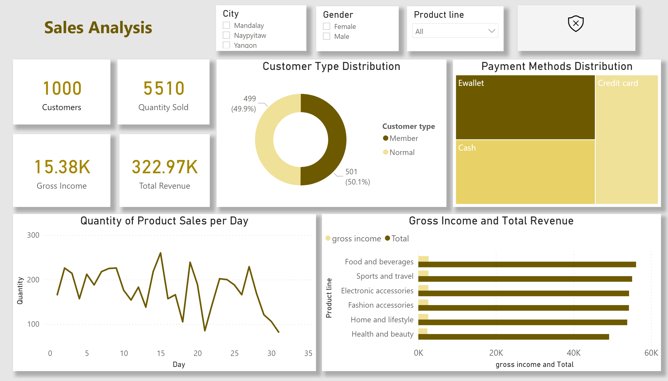
General overview
Notes:
card
No alt text provided.
card
No alt text provided.
card
No alt text provided.
clusteredBarChart
No alt text provided.
slicer
No alt text provided.
slicer
No alt text provided.
Quantity of Product Sales per Day
No alt text provided.
Customer Type Distribution
No alt text provided.
Payment Methods Distribution
No alt text provided.
slicer
No alt text provided.
Customer Satisfaction
No alt text provided.
card
No alt text provided.
Gross Income and Total Revenue
No alt text provided.
textbox
No alt text provided.

